Slide 1
ROTARY DISTRICT 6900
DG JIM SQUIRE
2019-2020 Governor Citation & Service Project
Submission

Slide 2
2019-2020 Rotary International Awards
Governor’s Citation Updates and Changes on District Web site.
The District Governor’s Citation is a list of criteria in the areas of Service, Membership, Foundation and Leadership Development.
In each section, there are mandatory and other tasks to accomplish with points awarded for each.
The program is designed so that the club enters the appropriate information and the program automatically compiles a total score which is visible at the bottom left of the page.
This total changes with each entry or when each entry is modified. Each Club should be able to update their respective Club’s Governor’s Citation from May 1, 2019 until March 6, 2020.

Slide 3
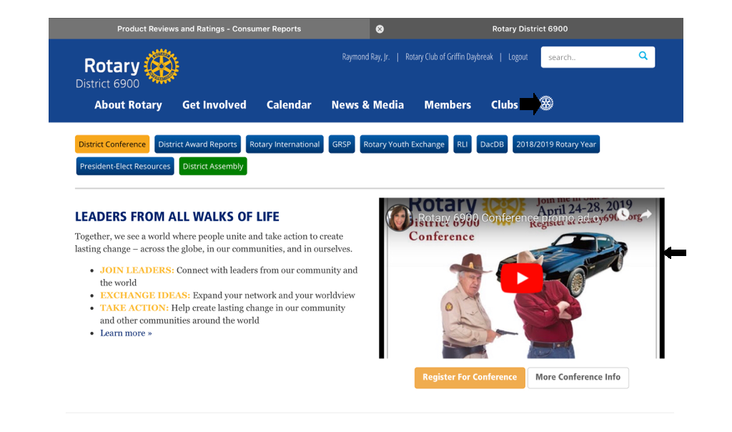
2019-2020 Rotary International Awards
After the Rotarian has logged into the District website (rotary6900.org), the District Governor’s Citation is found under “About Rotary” then under “District” then under the “2019-2020 Awards” header.

Slide 4
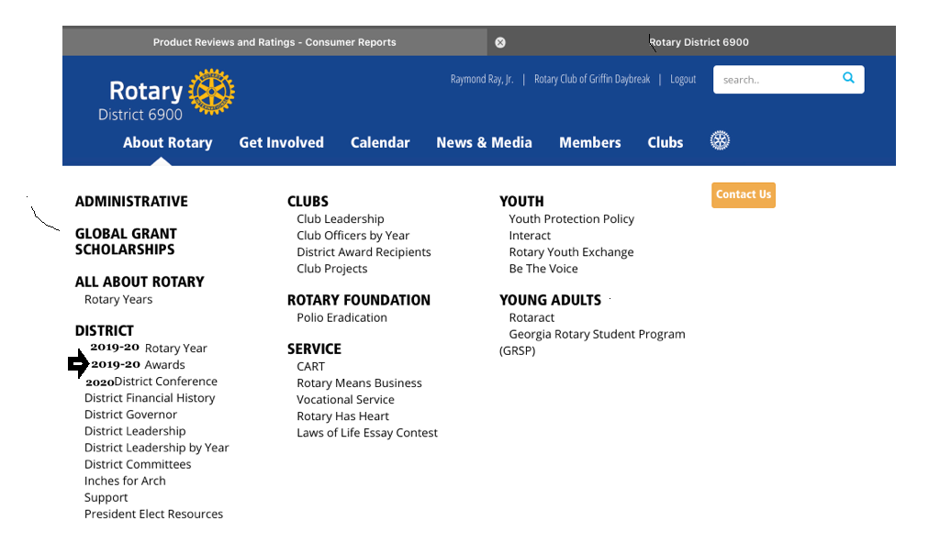
2019-2020 Rotary International Awards
After the Rotarian has logged into the District website (rotary6900.org), the District Governor’s Citation is found under “About Rotary” then under “District” then under the “2019-2020 Awards” header.

Slide 5
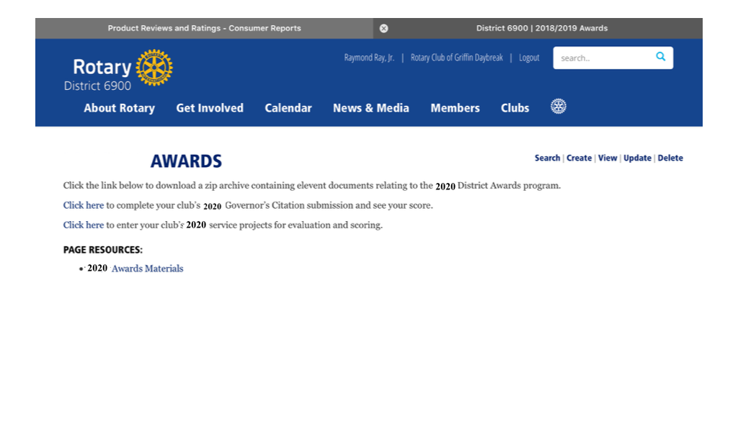
2019-2020 Rotary International Awards
After the Rotarian has logged into the District website (rotary6900.org), the District Governor’s Citation is found under “About Rotary” then under “District” then under the “2019-2020 Awards” header.

Slide 6
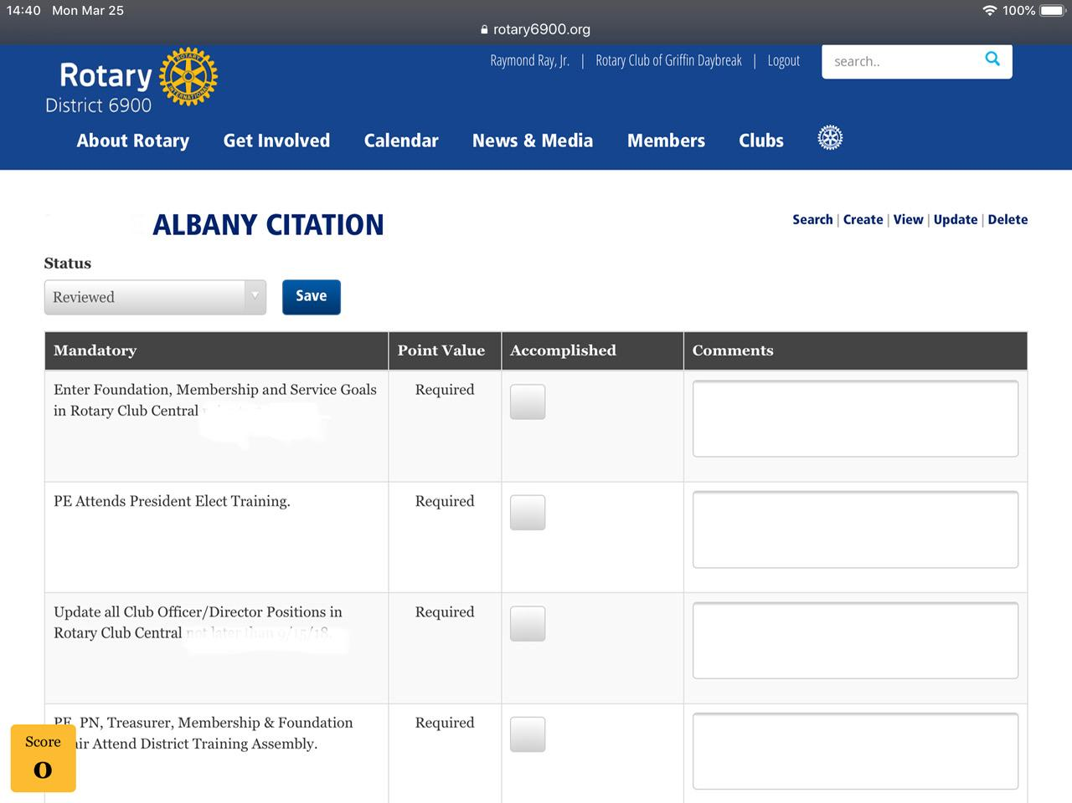
2019-2020 Rotary International Awards
CLICK HERE to complete or update your Club’s 2020 Governor’s Citation for submission and to see your score.

Slide 7
2019-2020 Rotary International Awards
Club Service Projects Submission on District Web site.
Clubs will submit a specific number of Service Projects for the Rotary year 2019-2020 to be evaluated and scored by the District Assistant Governors. The scores will be assist in determining the “Club of the Year Award.”
On March 6th, 2020, the district will compile & provide all submitted Club Service Projects to the to the AGs for evaluation & scoring.
The following instructions will inform you how to access the correct district web page and submit your assigned club service projects.

Slide 8
2019-2020 Rotary International Awards
Club Service Projects Submission on District Web site.

Slide 9
2019-2020 Rotary International Awards
Club Service Projects Submission on District Web site.

Slide 10
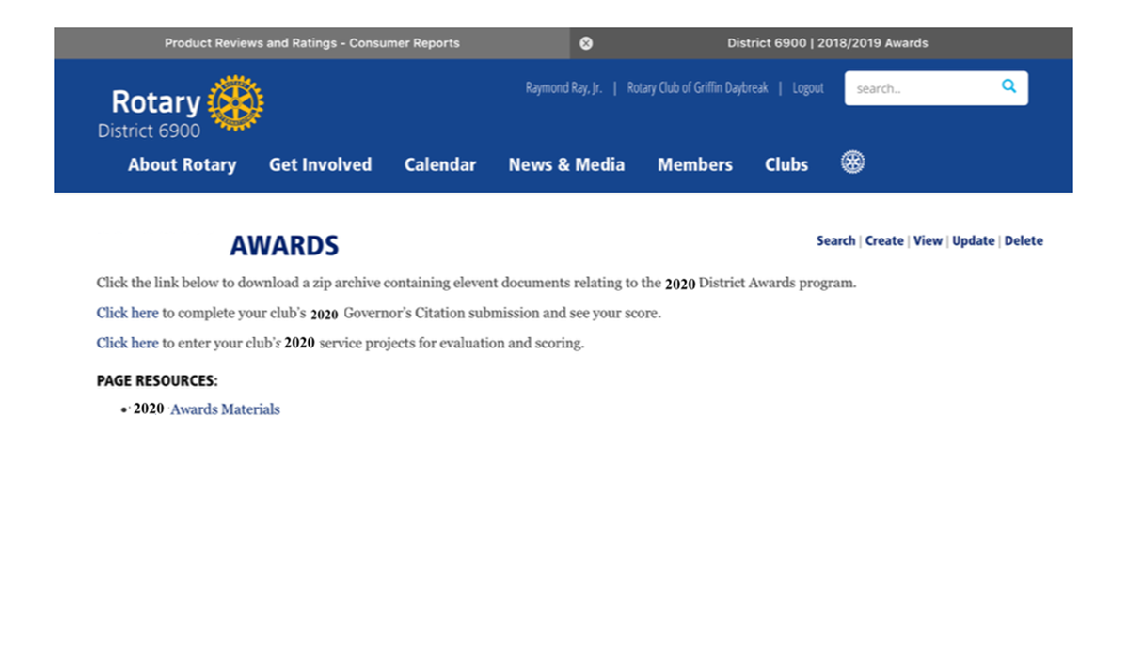
2019-2020 Rotary International Awards
Club Service Projects Submission on District Web site.

Slide 11
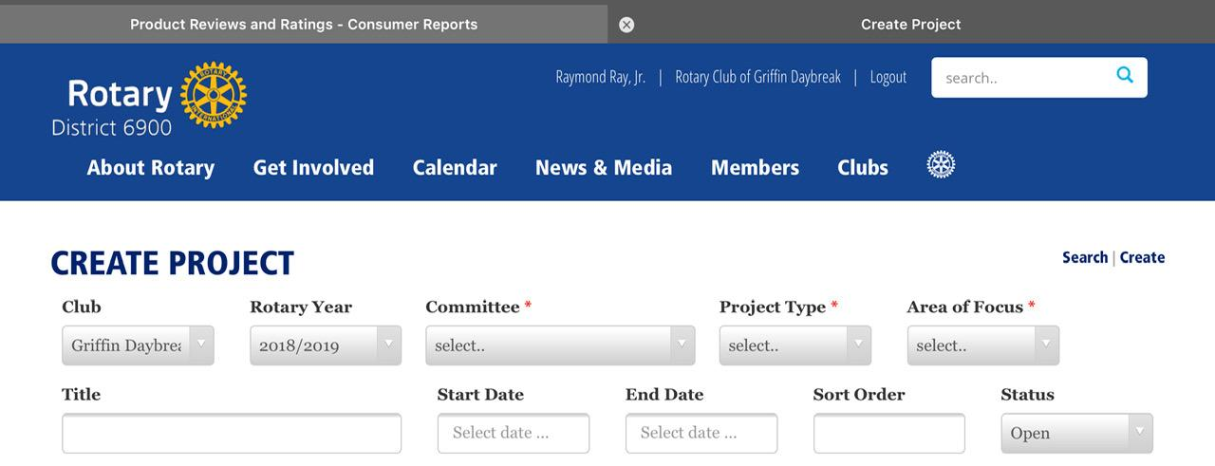
2019-2020 Rotary International Awards
Club Service Projects Submission on District Web site.

Slide 12
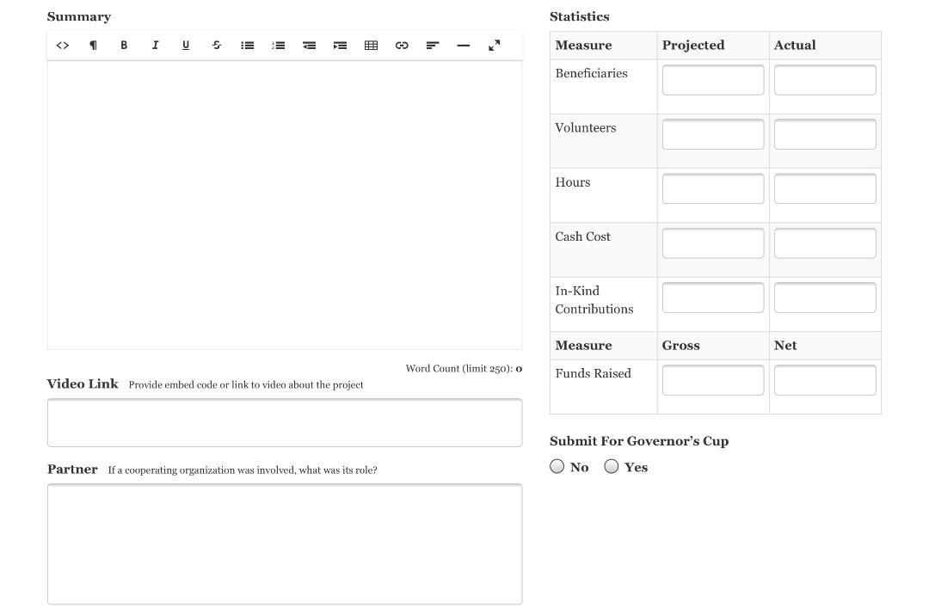
2019-2020 Rotary International Awards
Club Service Projects Submission on District Web site.

Slide 13
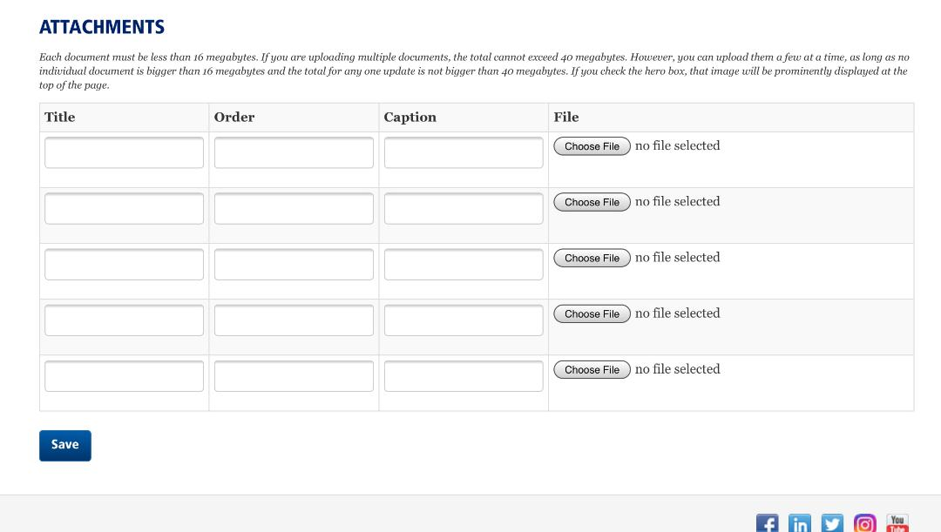
2019-2020 Rotary International Awards
Club Service Projects Submission on District Web site.

