Slide 1
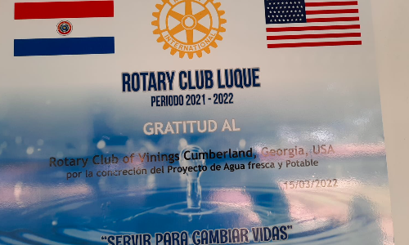
June
Vinings Cumberland International Service Trip
Paraguay - June 15 – June 23
- Agua Fresca Drinking Fountain Tours -
https://youtu.be/UaKMjfVYgjY?si=JqI84DHbbywnkHUA

Slide 2
Project History
The project resulted as a need to provide fresh, cold water to students in the summer months of extreme Paraguayan heat without AC when the local club advised that student attendance is low due to not having cool drinking water. The initial project took place in 2018 followed by a trip to Paraguay by Vinings Cumberland Rotarians to see the fountains and meet Luque, Paraguay Club Rotarians.
A second school was identified in 2019, however due to the pandemic the project was paused. In 2022 Vinings Cumberland Rotary in partnership with Rotary in Paraguay did deliver a second project and the hope is to now scale this repeatable project to more schools in Paraguay. The Vinings Cumberland Rotary Club has been invited by our Rotarians in Paraguay to visit in Summer of 2024 by which time we hope to have reached additional schools with this cool, fresh water, AGUA FRESCA!
Rotary Luque in Paraguay and Rotary Vinings Cumberland now plan to expand to additional schools in the region over a 1 year period and estimate the cost at $30,000 which consists of 13 schools and 4,752 students and teachers. Rotary Luque has a very strong Rotoract program and Rotary Vinings Cumberland has a very strong Interact program at Campbell High School in Smyrna, GA. We plan to integrate both the Rotoract and Interact clubs in this project to further strengthen cultural and service awareness.

Slide 3
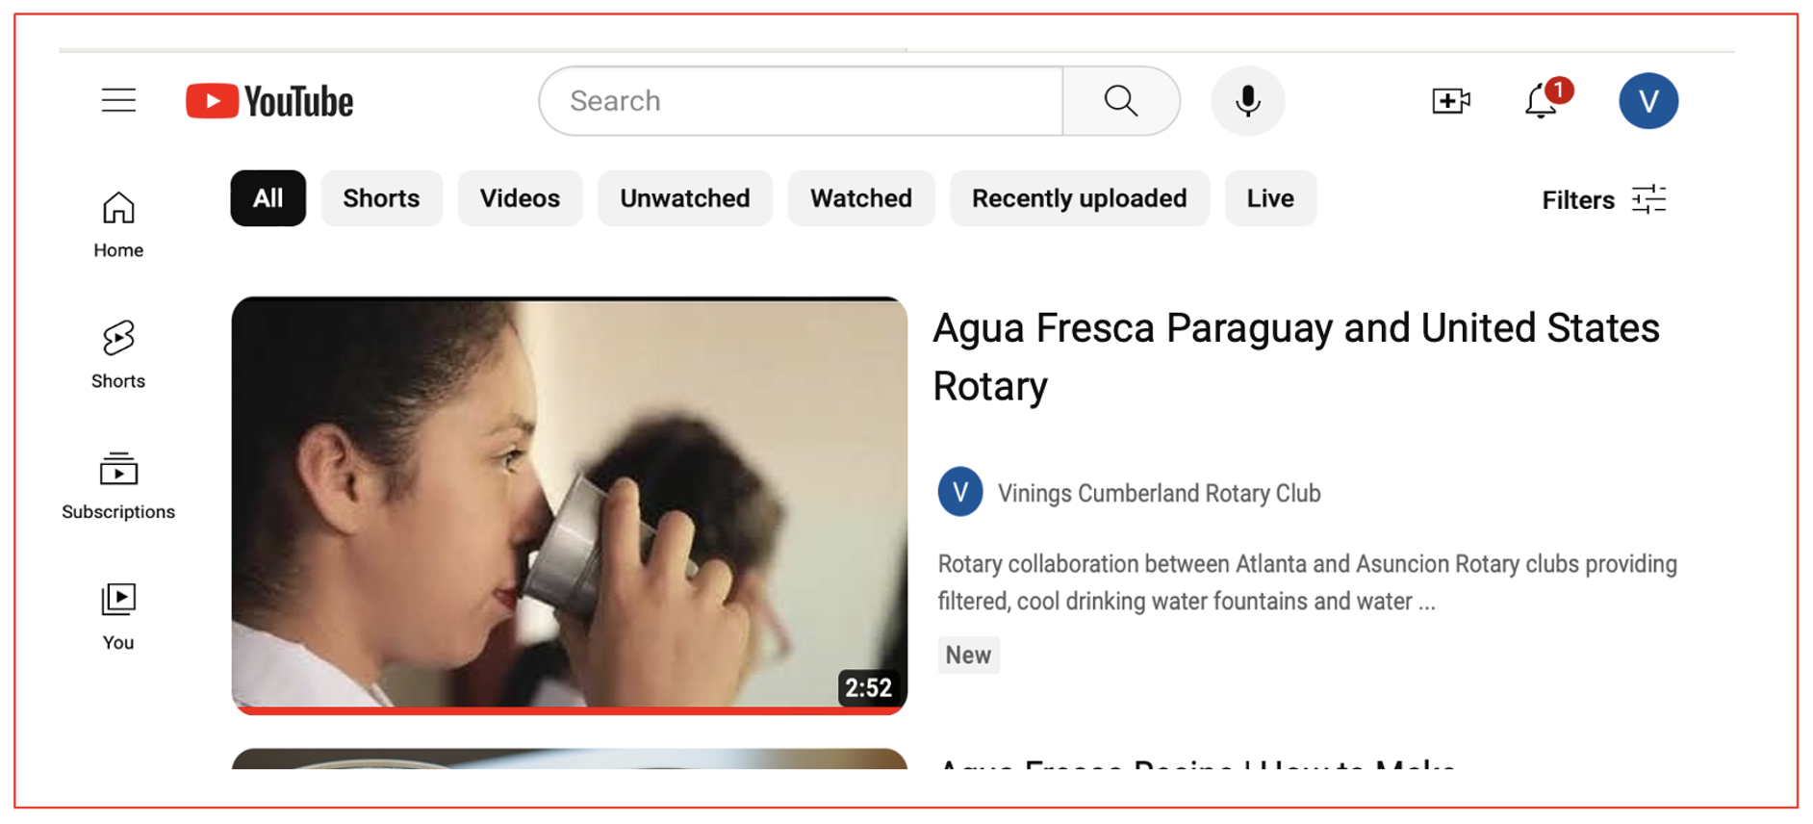
Overview Video of Second ‘Agua Fresca’ Fountain Delivered in Paraguay
https://youtu.be/UaKMjfVYgjY?si=SlTjfI3_HduM6sWp

Slide 4
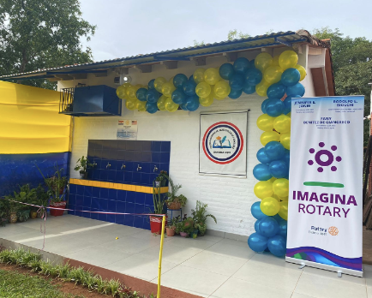
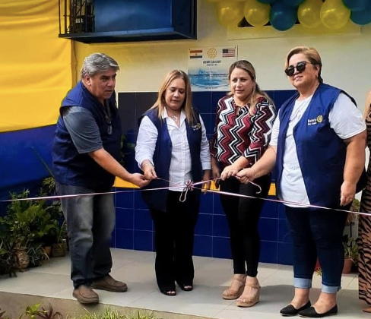
June
Depart Atlanta
Arrive in Luque and Meet Host Families
Visit Asuncion
Luque Rotary Club Meeting
Agua Fresca in Luque and Nueva Italia
Ciudad del Este and Iguacu Falls
Return from Iguacu Falls
Visit with Luque Rotarians
Depart Paraguay

Slide 5
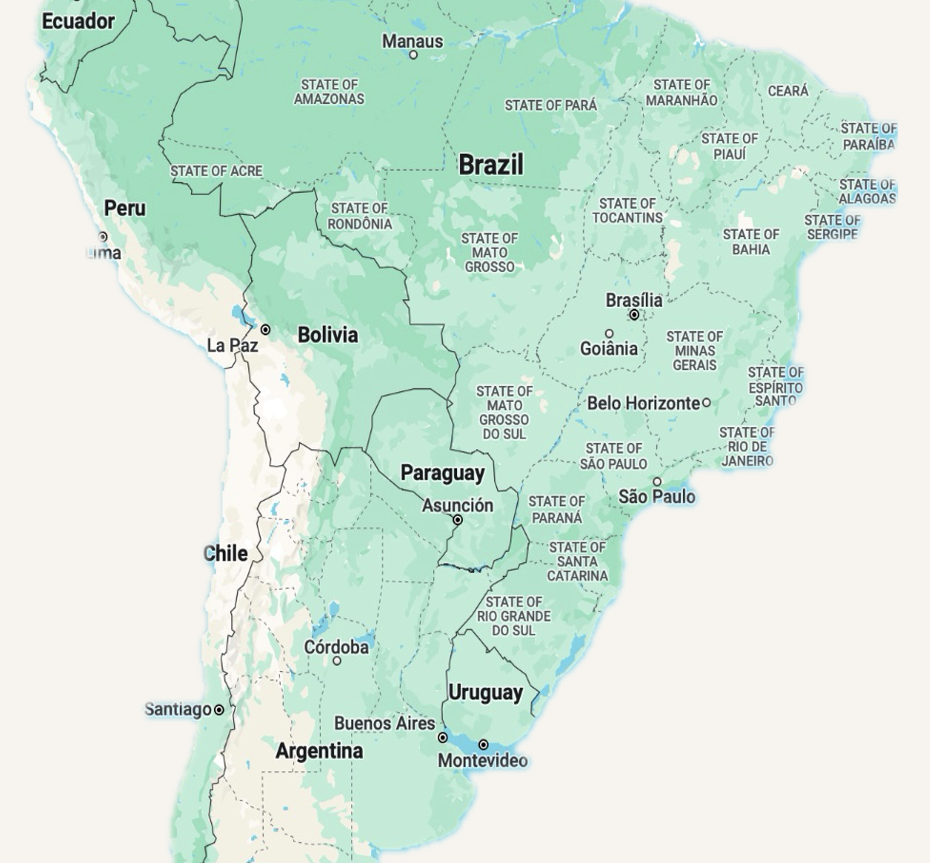
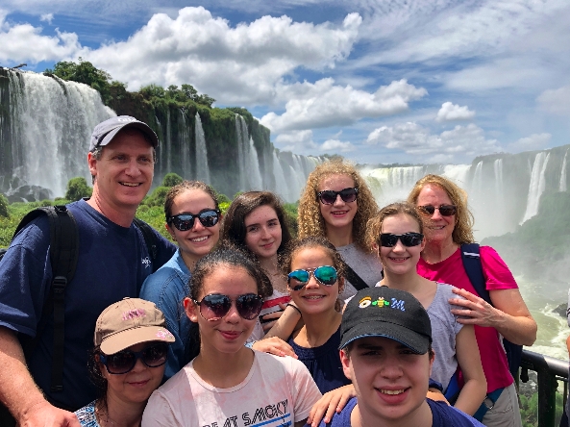
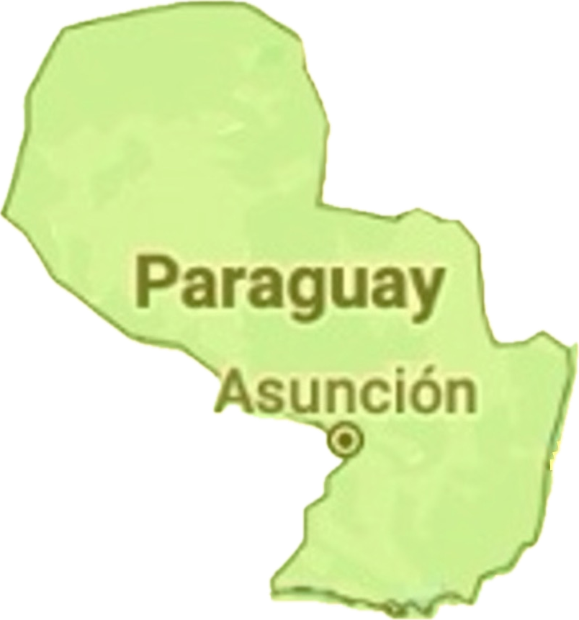
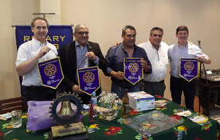
Agua Fresca Fountains
Iguacu Waterfalls
Luque Rotary Meeting
Rotary Host Families

Slide 6
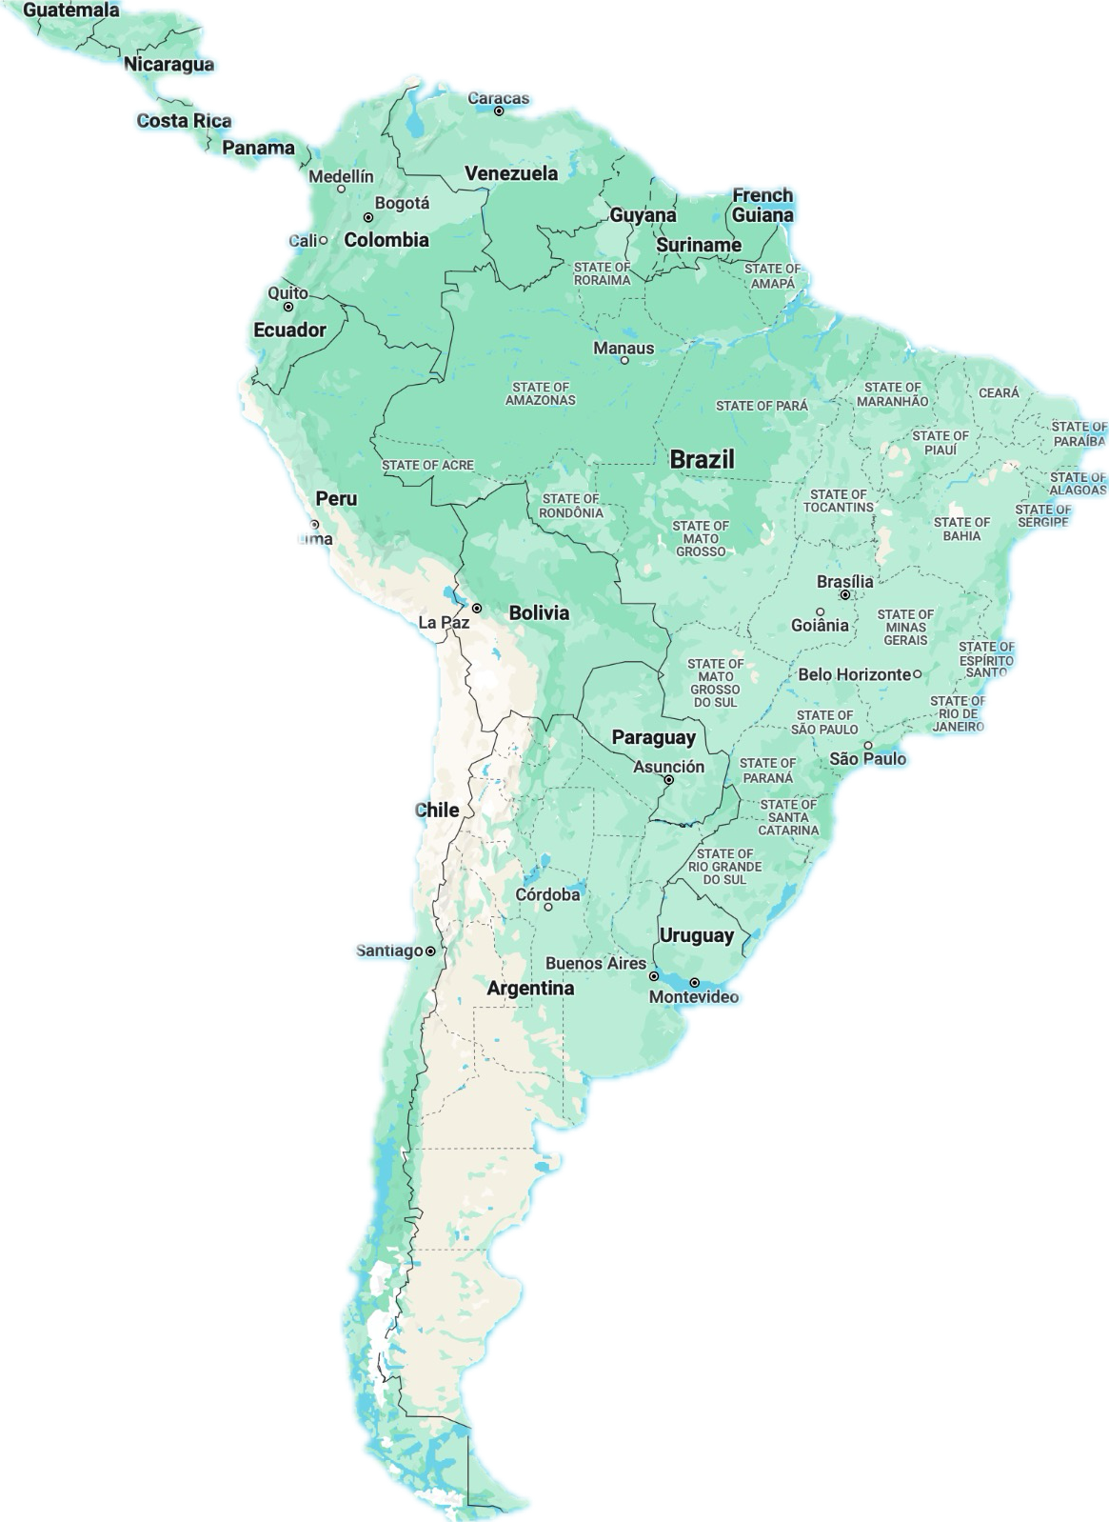
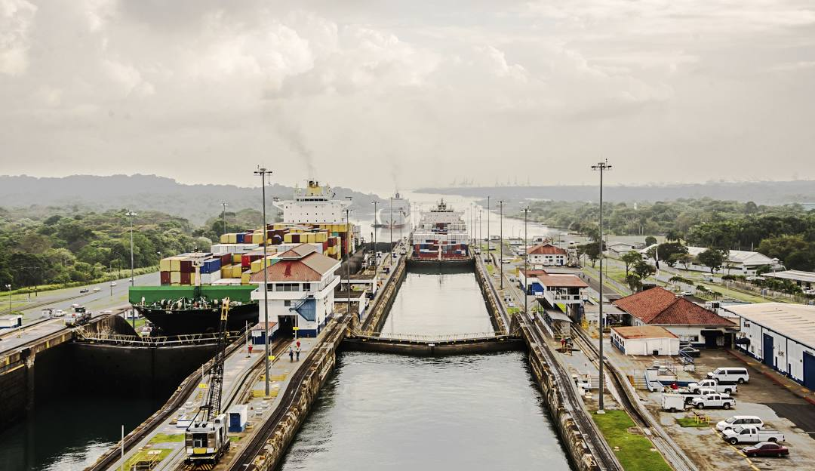
AFTER
Panama Canal
Rio de Janeiro
Travel with Copa Airlines and take a daytrip to the Panama Canal on a planned layover during the day
The Campbell Family plan traveling to Rio de Janeiro on June 24th and stay through June 28th in Copacabana Hilton pictured above
Plan to travel to Chile after Paraguay and return to Atlanta

Slide 7
Airfare
Updated on 03-31-2024
All Fares include one checked bag and the fare will be less if you are traveling with a carry-on only
Hotel is NOT required as we have Luque, Paraguay Rotary Club host families looking forward to hosting us. If you do want to stay in a hotel they range from $50-$150 nightly

Slide 8
Visas
NO Visa Required:
Paraguay
Argentina
Chile
Panama
Visa Required:
Brazil
- eVisa at https://brazil.vfsevisa.com
For More Information
Contact Brant Campbell via:
mobile 470-773-2767 or
email: brantcampbell@yahoo.com
Download This Document
https://www.viningsrotary.org/resource/1365

