Slide 1
the Spirit of Dunwoody
2016-17 Year In Review

Slide 2
IT Starts with our leadership tradition
At our annual “birthday” breakfast, 13 past presidents and DG Bob Hagan joined the celebration. And that’s not all the past presidents who remain active … at the Club, District and Rotary International levels, including three PDGs – Bill Mulkey, Bill Woulfin and Robert Hall, who just completed his term as an RI Director.

Slide 3
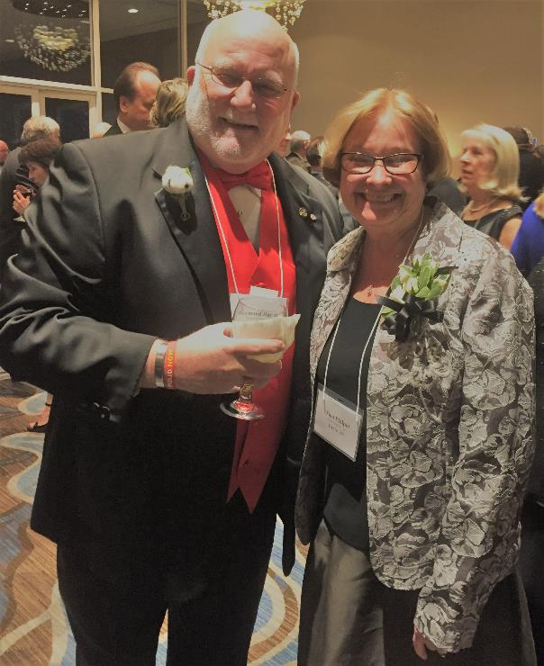
This year’s leaders
President Tina Philpot with District Governor Raymond Ray at the 2017 Governor’s Ball
Officers
Tina Philpot, President
Rick Otness, President Elect
Rick Woods, President Nominee
Cathie Brumfield, Secretary
Larry Domenico, Treasurer
Chris Smith, Sgt-at-Arms
Lorri Christopher, Past President
Scott Jennings, Pres. Advisor
PDG Bill Mulkey, Pres. Emeritus
Directors
Louise Barden, International
Ardy Bastien, Club Admin
David Gordon, Membership
Craig Gregozeski, Foundation
Brian Harper, Youth Services
Dottie Ransom, Public Image
Carter Stout, Director at Large
Bill Thiele, Community Service

Slide 4
And our 2017-18 leaders
Announced at our annual holiday luncheon

Slide 5
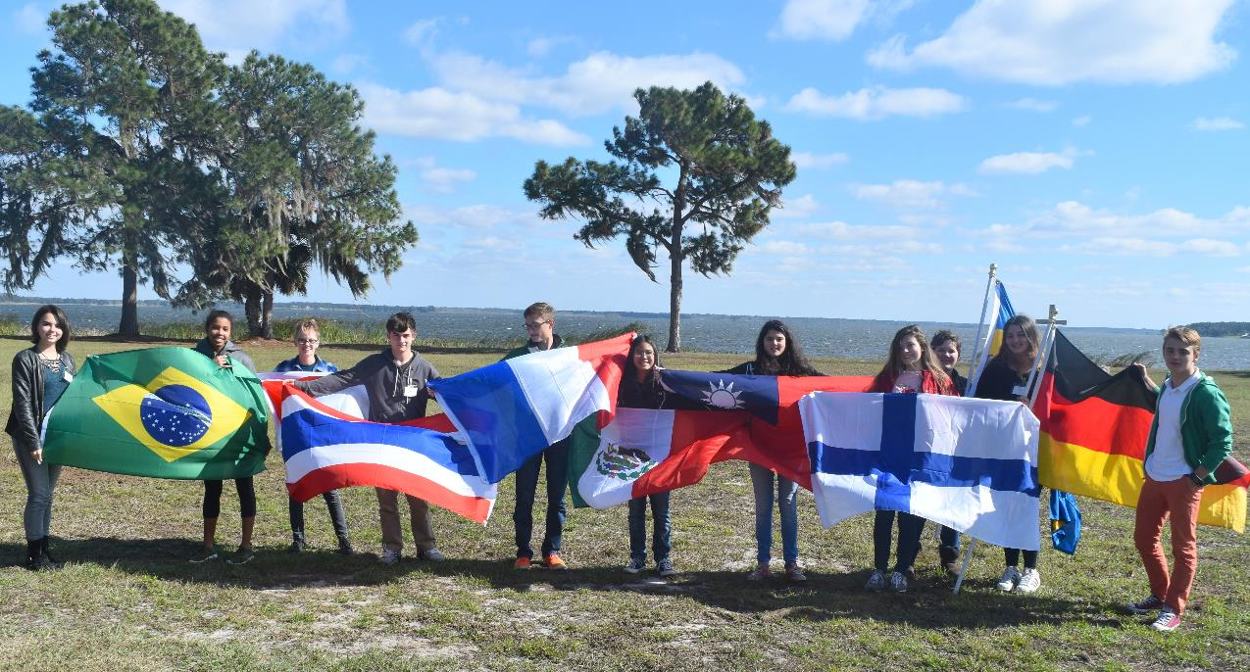
We DARE TO INSPIRE YOUTH … locally and around the world

Slide 6
We DARE TO INSPIRE YOUTH … locally and around the world
Books for Dresden
Rotary Youth Exchange
Georgia Rotary Student Program
Junior Achievement
Peachtree Charter Middle Quiz Bowl
Character Education
Dunwoody High Interact Club
Rotaract Club of Metro Atlanta

Slide 7
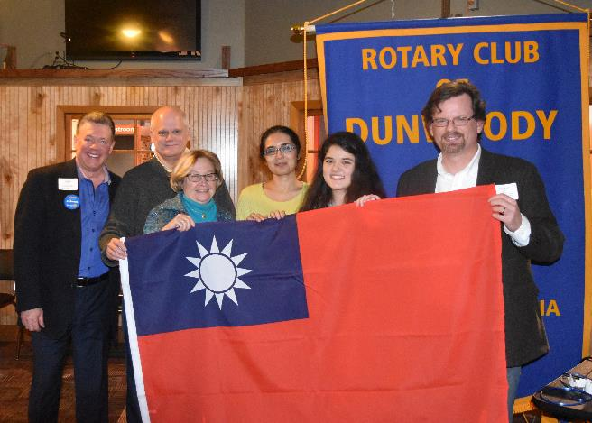
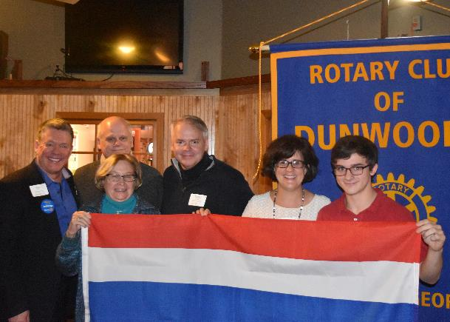
Launching rotary youth exchange
New District effort led by Dunwoody Rotarian Michael Parks, an RYE alumnus
Club sponsoring two Dunwoody High students for 2017-18 school year … Yasmeen Herb (left) visits Taiwan and Henry O’Connor (top) visits Thailand

Slide 8
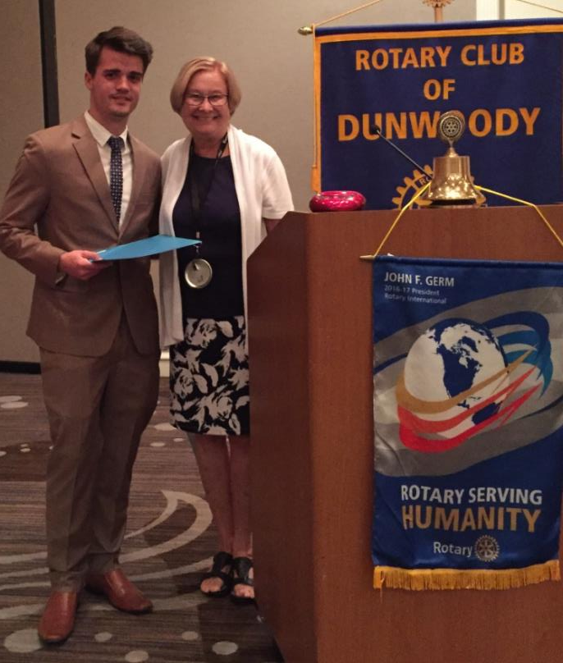
Supporting Georgia rotary student program
Marc Gevers, South Africa
Our 33rd GRSP student
Host Family: David & Judy Gordon
Lorri Christopher, GRSP Secretary
Jackie Cuthbert, Line Trustee
Sponsor: GRSP Leadership Weekend

Slide 9
Hosting GRSP Leadership weekend
Chair: Louise Barden, International Service Director

Slide 10
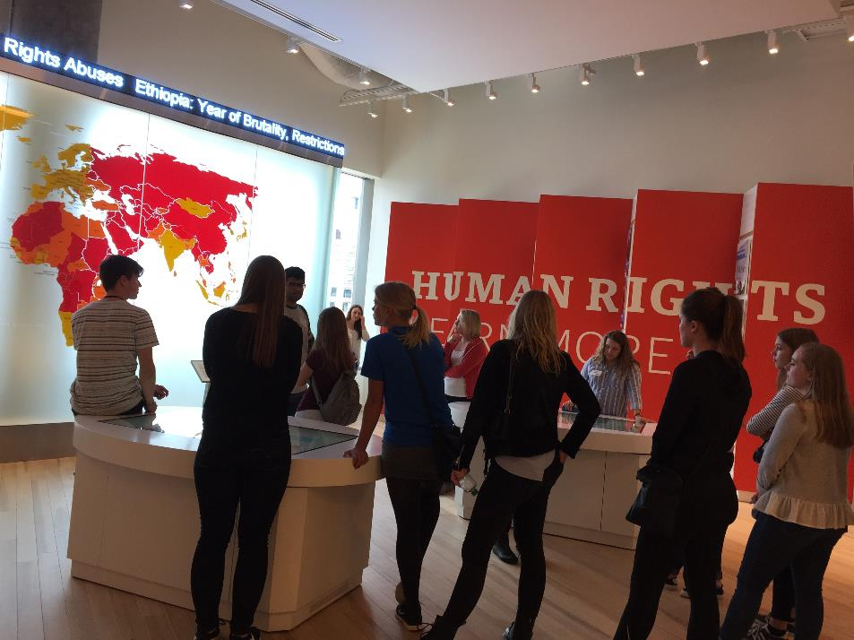
STARTING with Visit to Center for Civil and Human Rights

Slide 11
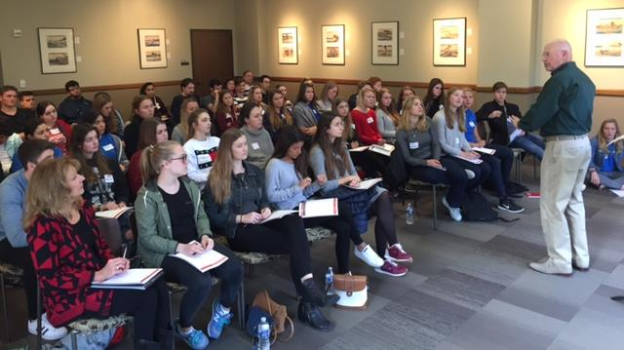
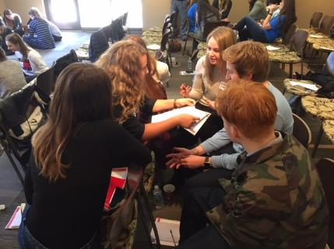
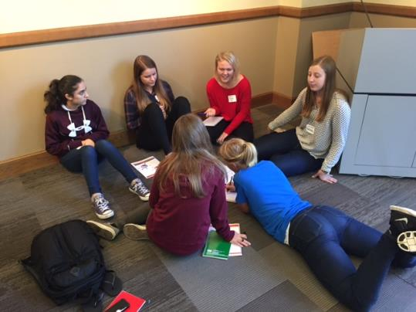
And continuing with fierce conversations …
A workshop on communication skills facilitated by PP Larry Hart

Slide 12
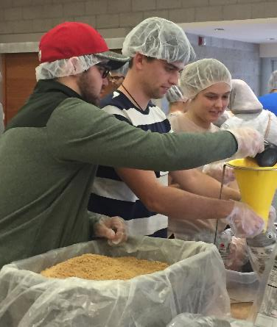
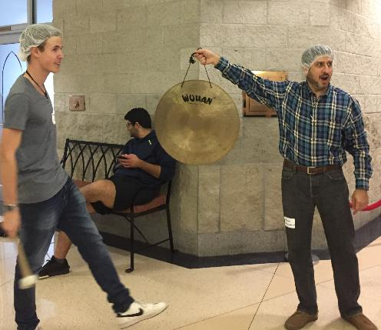
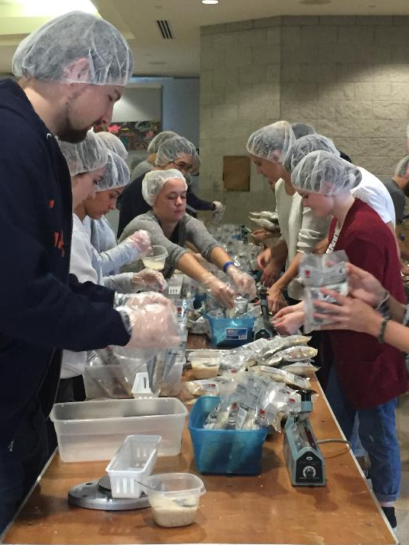
Packing meals to feed 10,000 people …
With Rotarian Hoshi Daruwalla having students sound the gong to celebrate each 1,000 meals packed

Slide 13
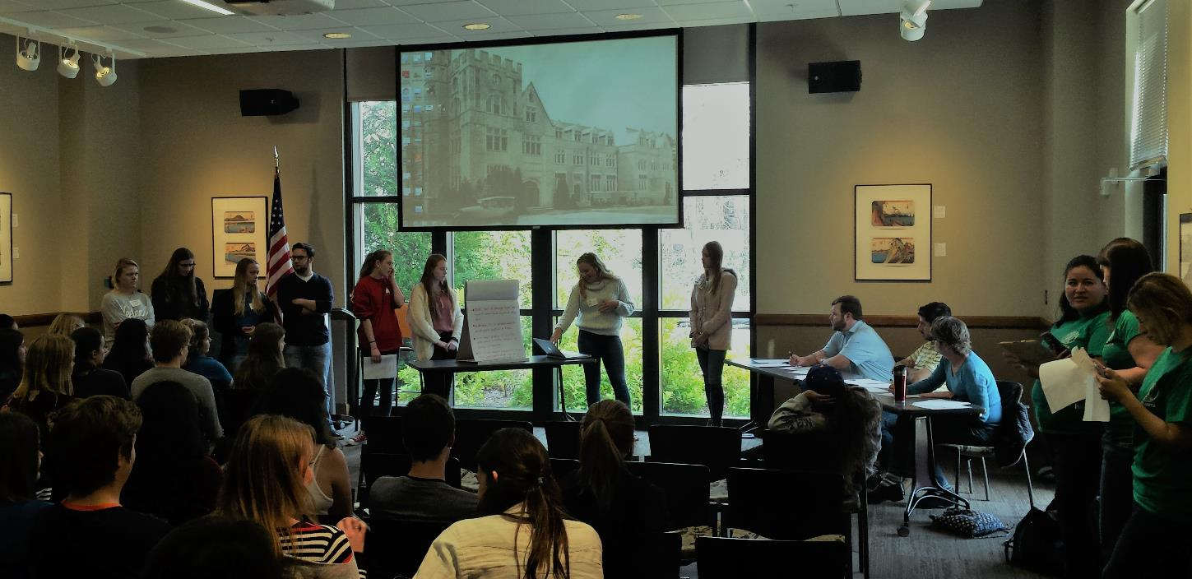
And presenting programs to serve humanity
In a “Shark Tank” facilitated by Rotaract Club of Metro Atlanta GRSP students brainstorm ideas for making a difference in the world

Slide 14
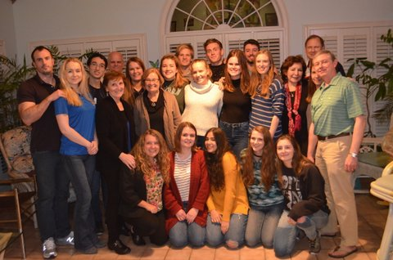
Thanks to our LEADERSHIP weekend partners
Georgia Rotary Student Program
DeKalb Rotary Council
Rotary Club of Atlanta
Rotary Club of Brookhaven
Rotary Club of Buckhead
Rotary Club of North Atlanta
Rotary Club of Roswell
Rotaract Club of Metro Atlanta
Our weekend host families
Our Saturday dinner hosts Cathie Brumfield, Jennie Stipick and Carter Stout

Slide 15
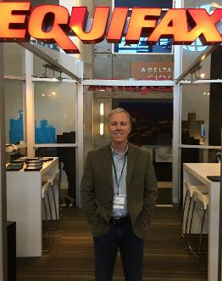
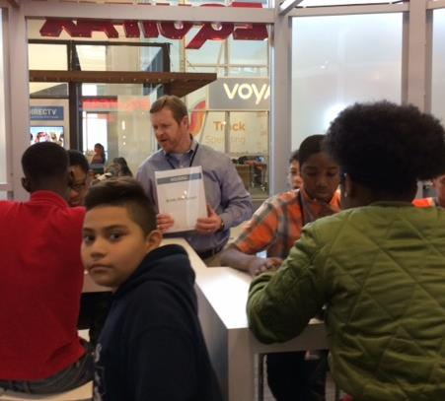
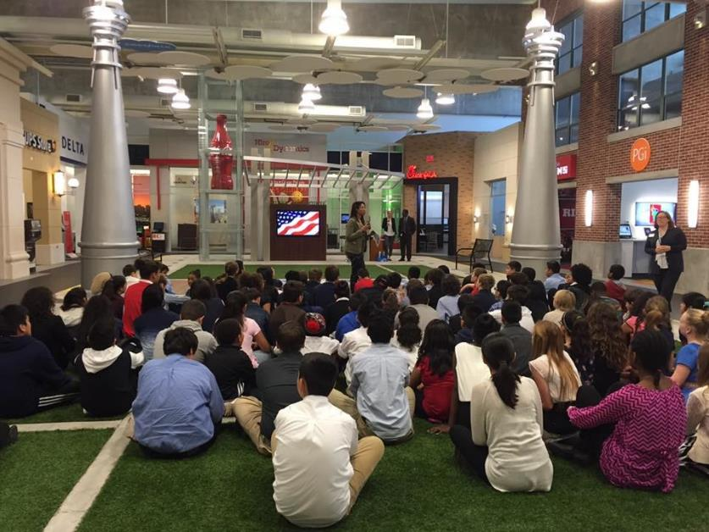
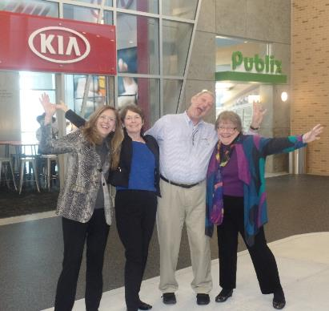
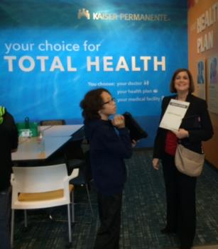
Volunteering for Junior achievement
Building financial literacy by volunteering at Chick-Fil-A Foundation JA Discovery Center

Slide 16
Coaching PCMS for Quiz Bowl 2017: Everyone wins!
Each year, Dunwoody Rotarians coach the Peachtree Charter Middle School Quiz Bowl team – readying them for inter-school competitions and their face-off with Dunwoody Rotary. This year, Rotarians pulled out their second win in a row!

Slide 17
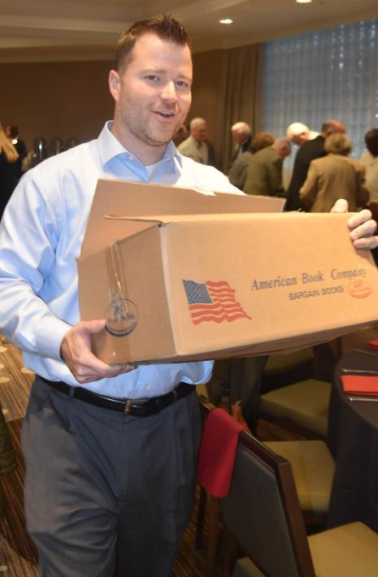
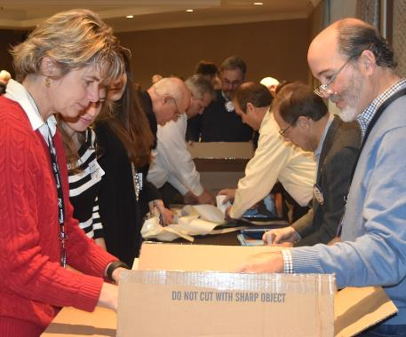
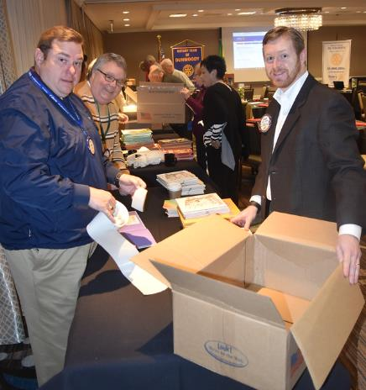
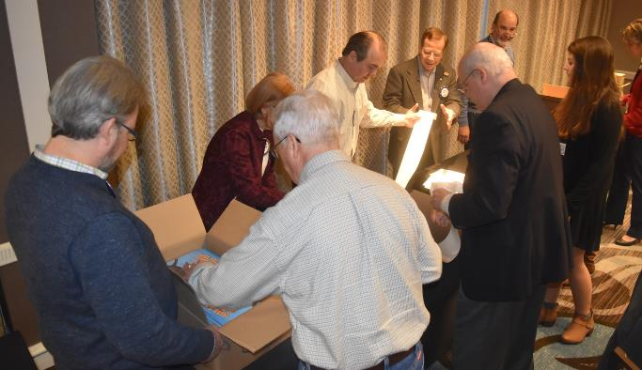
GIVING BOOKS TO DRESDEN: 20-Year tradition
During the holidays, Dunwoody gives a new book to each student at Dresden Elementary. At a regular meeting, Jack Clark (left) led Rotarians in adding bookplates. The result …

Slide 18
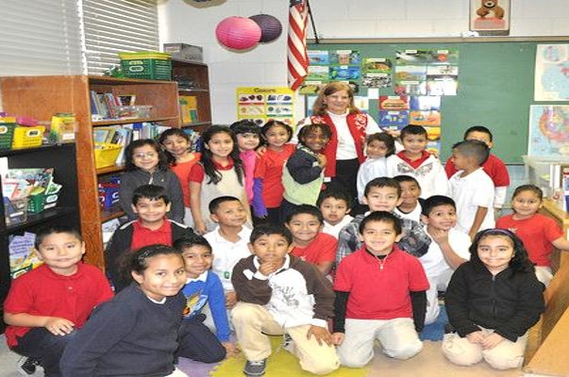
GIVING BOOKS TO DRESDEN: 20-Year tradition
Children who dare to be better readers … with a personal library stocked by the Rotary Club of Dunwoody

Slide 19
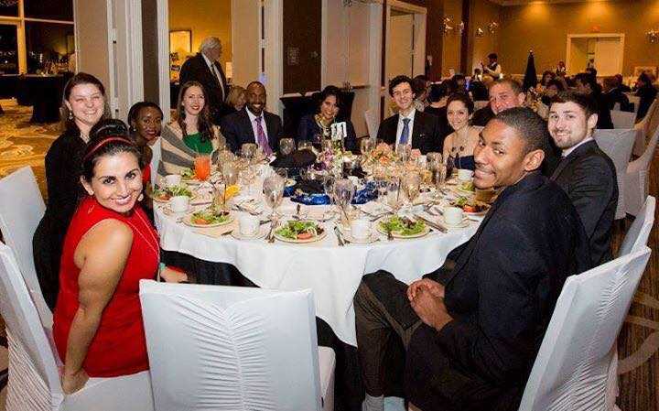
Sponsoring INTERACT AND ROTARACT
Dunwoody High School Interact Club with President Tina at a Friday meeting
The Atlanta Metro Rotaract Club is an active partner in our Governor’s Ball, RunDunwoody and the GRSP Leadership Conference.

Slide 20
We dare to dream of a better world and support that vision
Fourth of July
Monroe Park
RFHA Family Health Days
The Rotary Foundation
Georgia State Perimeter: Health Care Scholarships
Dunwoody Stage Door Players: School Play about Bullying
USO
Toys for Tots
Honoring First Responders
Community Assistance Center (CAC)

Slide 21
Supporting the Rotary Foundation as of February 20, 2017
Total 2016-17 Giving:
$125,811.78
37 New Paul Harris Fellows for 2016-2017
619 Total PHF
Total All-Time Giving:
$1,161,581.64

Slide 22
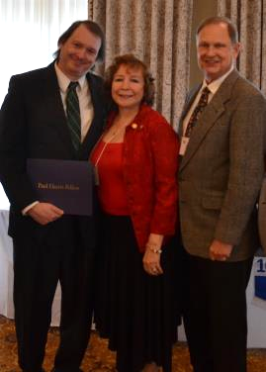
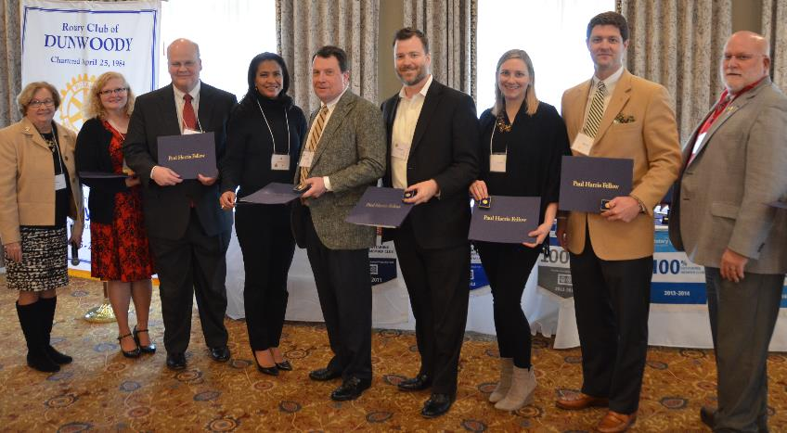
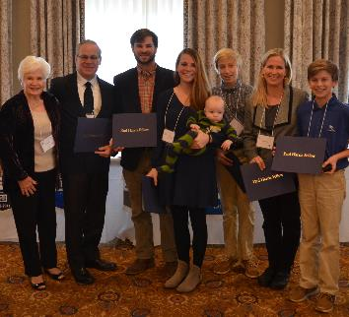
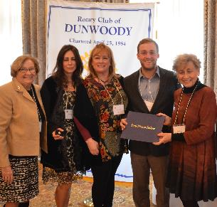
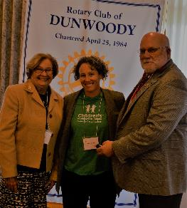
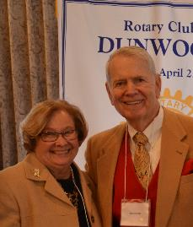
Among our new AND continuing TRF SUPPORTERS …

Slide 23
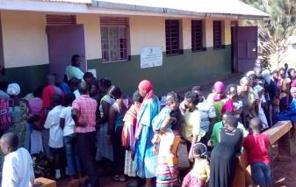
Supporting Family Health Days in Africa
Partnering with other D6900 Clubs to provide health services to more than 300,000 people in three days … thanks to a TRF grant

Slide 24
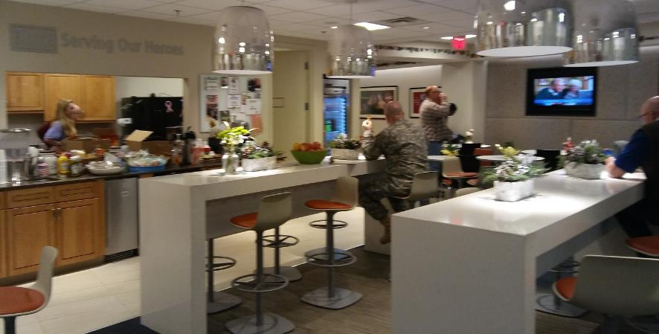
HONORING OUR MILITARY
We serve twice a year at the Atlanta Airport’s USO – and make a donation to support USO work on behalf of veterans. And, at Rotarian Charlie Augello’s East 48th Market, customers can donate money to help pay for phone cards for our protectors.

Slide 25
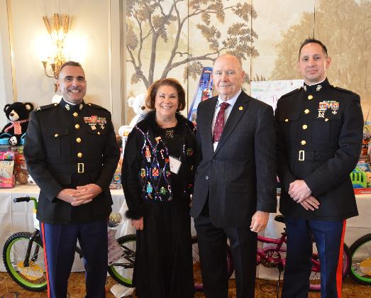
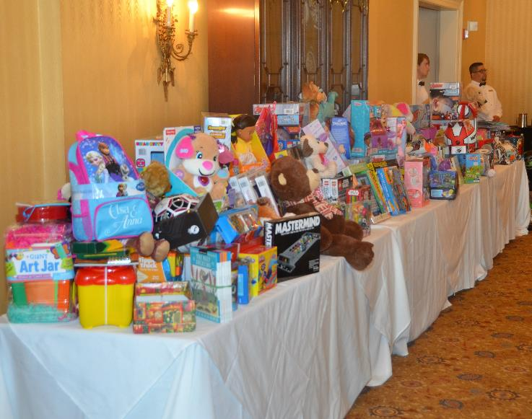
Bringing a Toy to Lunch … Our Holiday Tradition
Dunwoody coordinators Janet and Jim Glass with our Marine Corps visitors

Slide 26
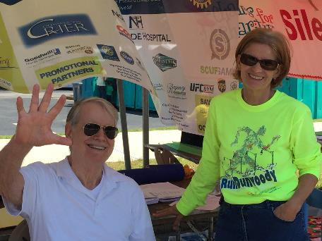
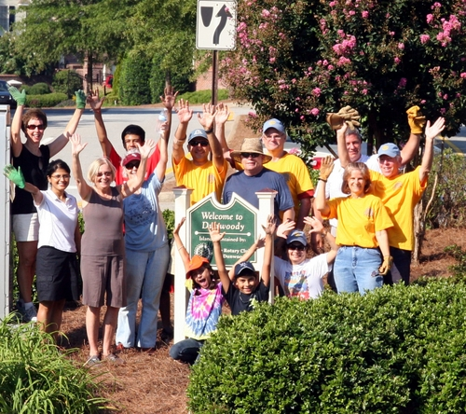
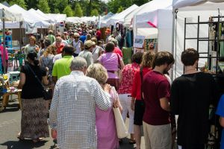
Daring to serve in Dunwoody
Sponsoring State of the City Event
Maintaining “Monroe Park” traffic island with “Ranger Fred” Bounds

Slide 27
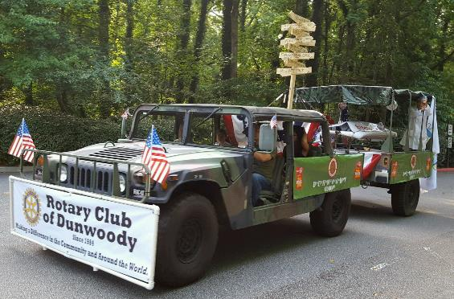
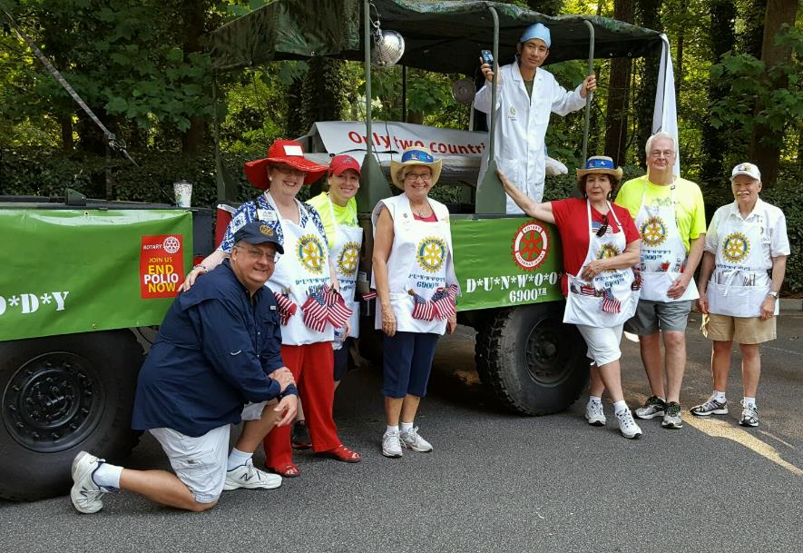
Dunwoody 4th of July
We celebrated a Happy New (Rotary) Year at the annual Dunwoody July 4 parade – with a MASH-themed float focused on End Polio Now, and a hot dog booth featuring roll back $1 prices (free to military)!

Slide 28
WE DARE TO enjoy our family of Rotary
Holiday Luncheon
GRSP Student Welcome Party
Governors Ball
St. Patrick’s Day with Singer Cindy Lou Harrington
Fourth of July
End of Year Celebration
RunDunwoody

Slide 29
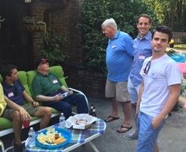
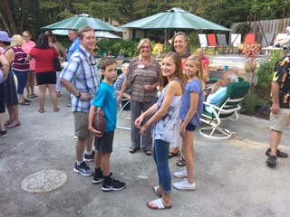
GRSP Welcome Party
Rotarians gathered at the Woulfins to throw a welcome party – coincidentally Marc’s birthday!

Slide 30
Holiday Luncheon
Dresden Elementary School choir kicked off the celebration with their musical sunshine. Dunwoody has been a partner to Dresden for nearly 20 years.

Slide 31
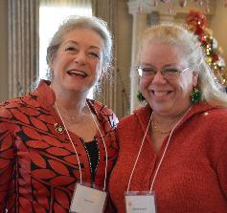
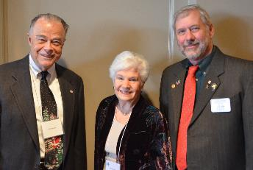
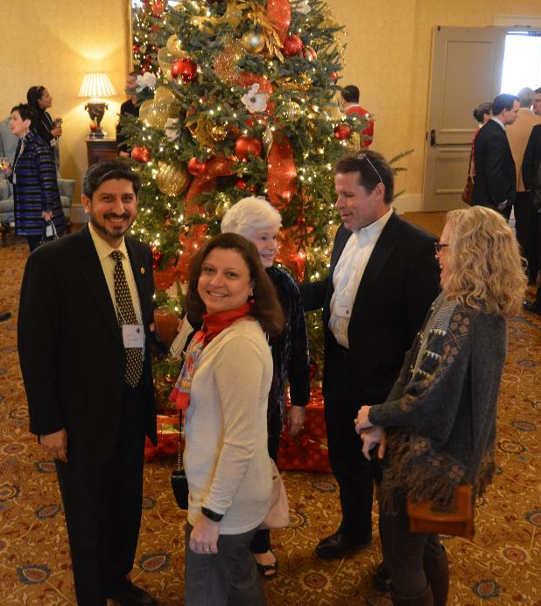
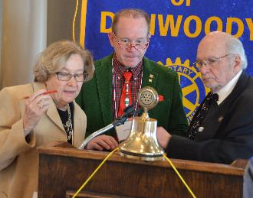
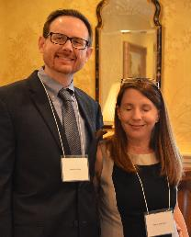
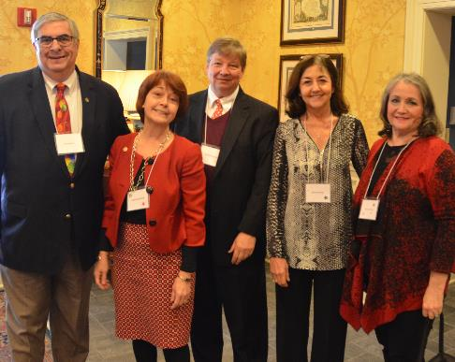
SHARING HOLIDAY CHEER

Slide 32
remembering Dennis Crean: Honorable Georgia Citizen
Rotarian Dennis Crean was honored posthumously at the holiday luncheon as an “Honorable Georgia Citizen” by the State. State Rep. Tom Taylor worked with Secretary of State’s office and Governor’s office to honor Dennis. Pictured: Marie Crean and family with President Tina and government representatives.

Slide 33
RUNDUNWOODY
Our fall fundraiser … 5K Peachtree Qualifying run plus the Fun Run shown above. In 2016, we welcomed 480 runners and raised more than $42,000 in sponsor fees. Together with the Governors Ball in the spring, RunDunwoody funds the work we do to make a difference in our local community and around the world.

Slide 34
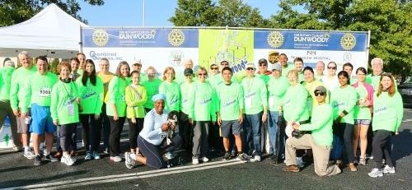
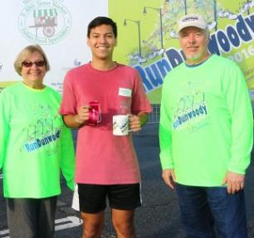
RUNDUNWOODY
Powered by volunteers from the Dunwoody Family of Rotary … including Rotarians and their families, the Atlanta Rotaract Club and Dunwoody High School Interact Club. Thanks to Bob O’Brien for leading this event!

Slide 35
RUNDUNWOODy: JUST A GLIMPSE

Slide 36
GOVERNOR’s Ball
Held Saturday, March 4, 2017 at the Westin Atlanta Perimeter North … we can assure you that it was a great party … and funds were raised to support the Rotary Club of Dunwoody as it “Dares to Be Better” and make a positive difference in the world.

Slide 37
Governor’s Ball … seems like last night (Oh it was!)

Slide 38
Dunwoody Rotary … in the news
A few of the many examples of Dottie Ransom’s fine work telling the Dunwoody story

Slide 39
The Rotary Club of Dunwoody
Daring to Be Better … Inspire Youth … Serve the Community and the World … Enjoy the Family of Rotary along the way!

