Slide 1
2018 District Conference
April 26 – 29, 2018
Sandestin Golf & Beach Resort
Miramar Beach, Florida

Slide 2
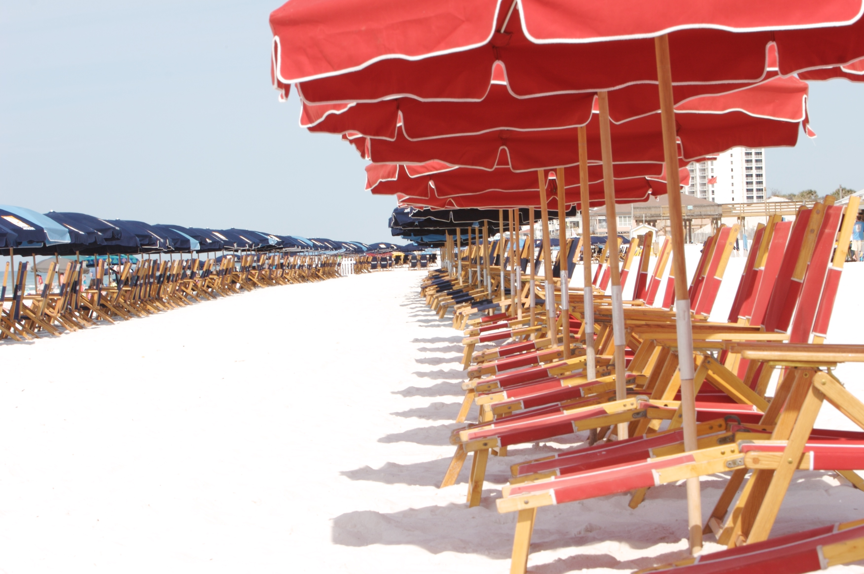

Slide 3
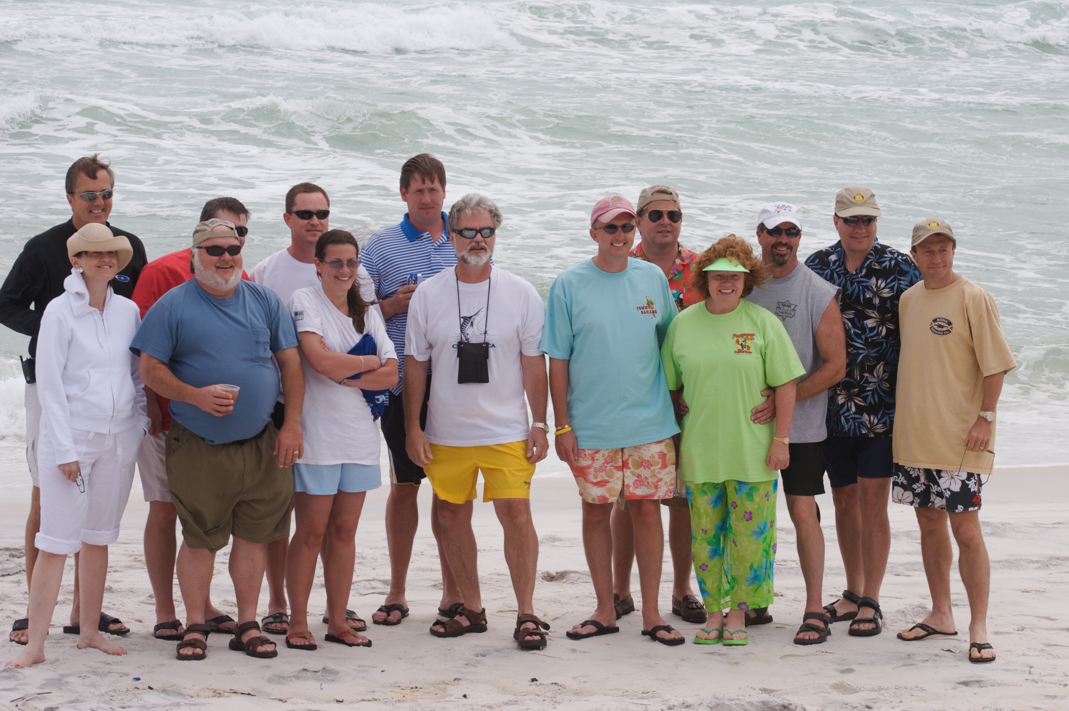
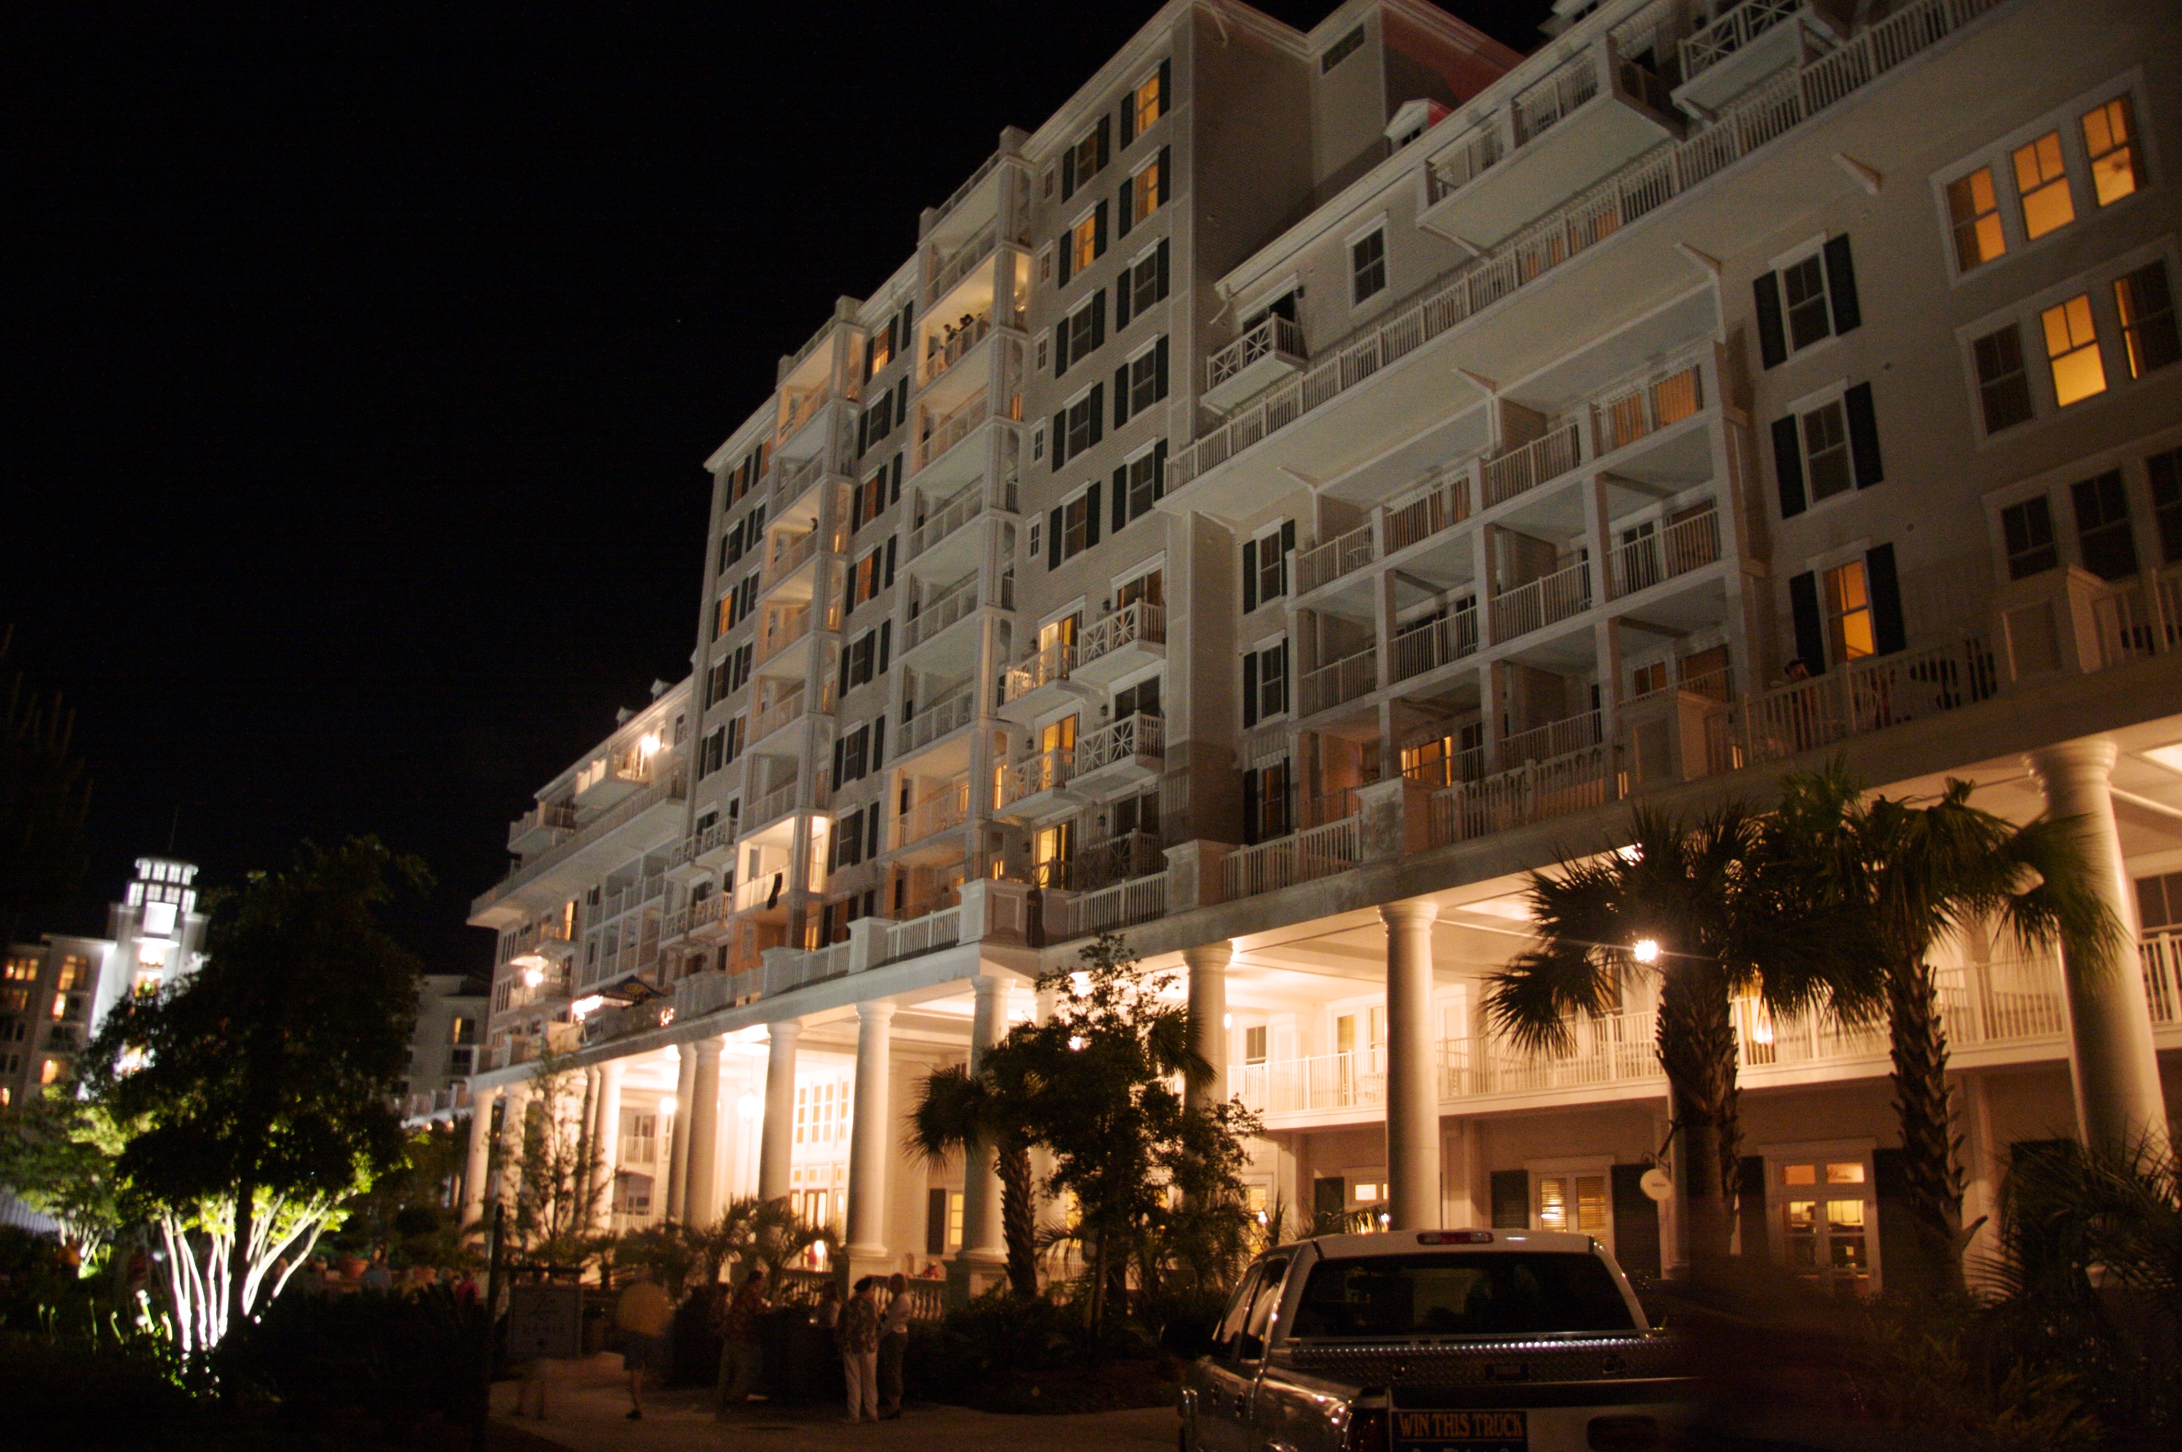
Enjoy Your Rotary Friends

Slide 4
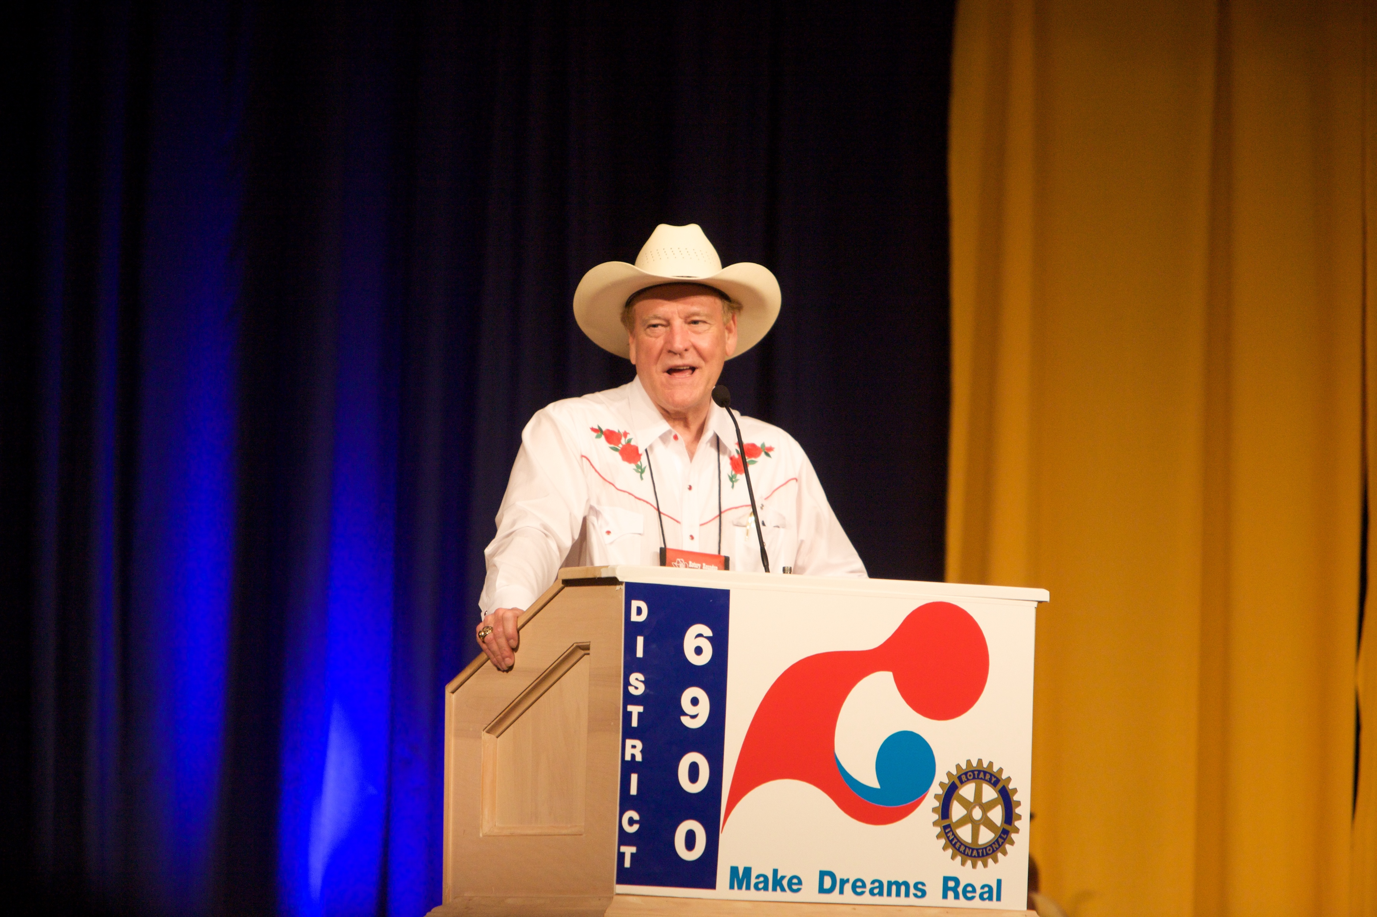
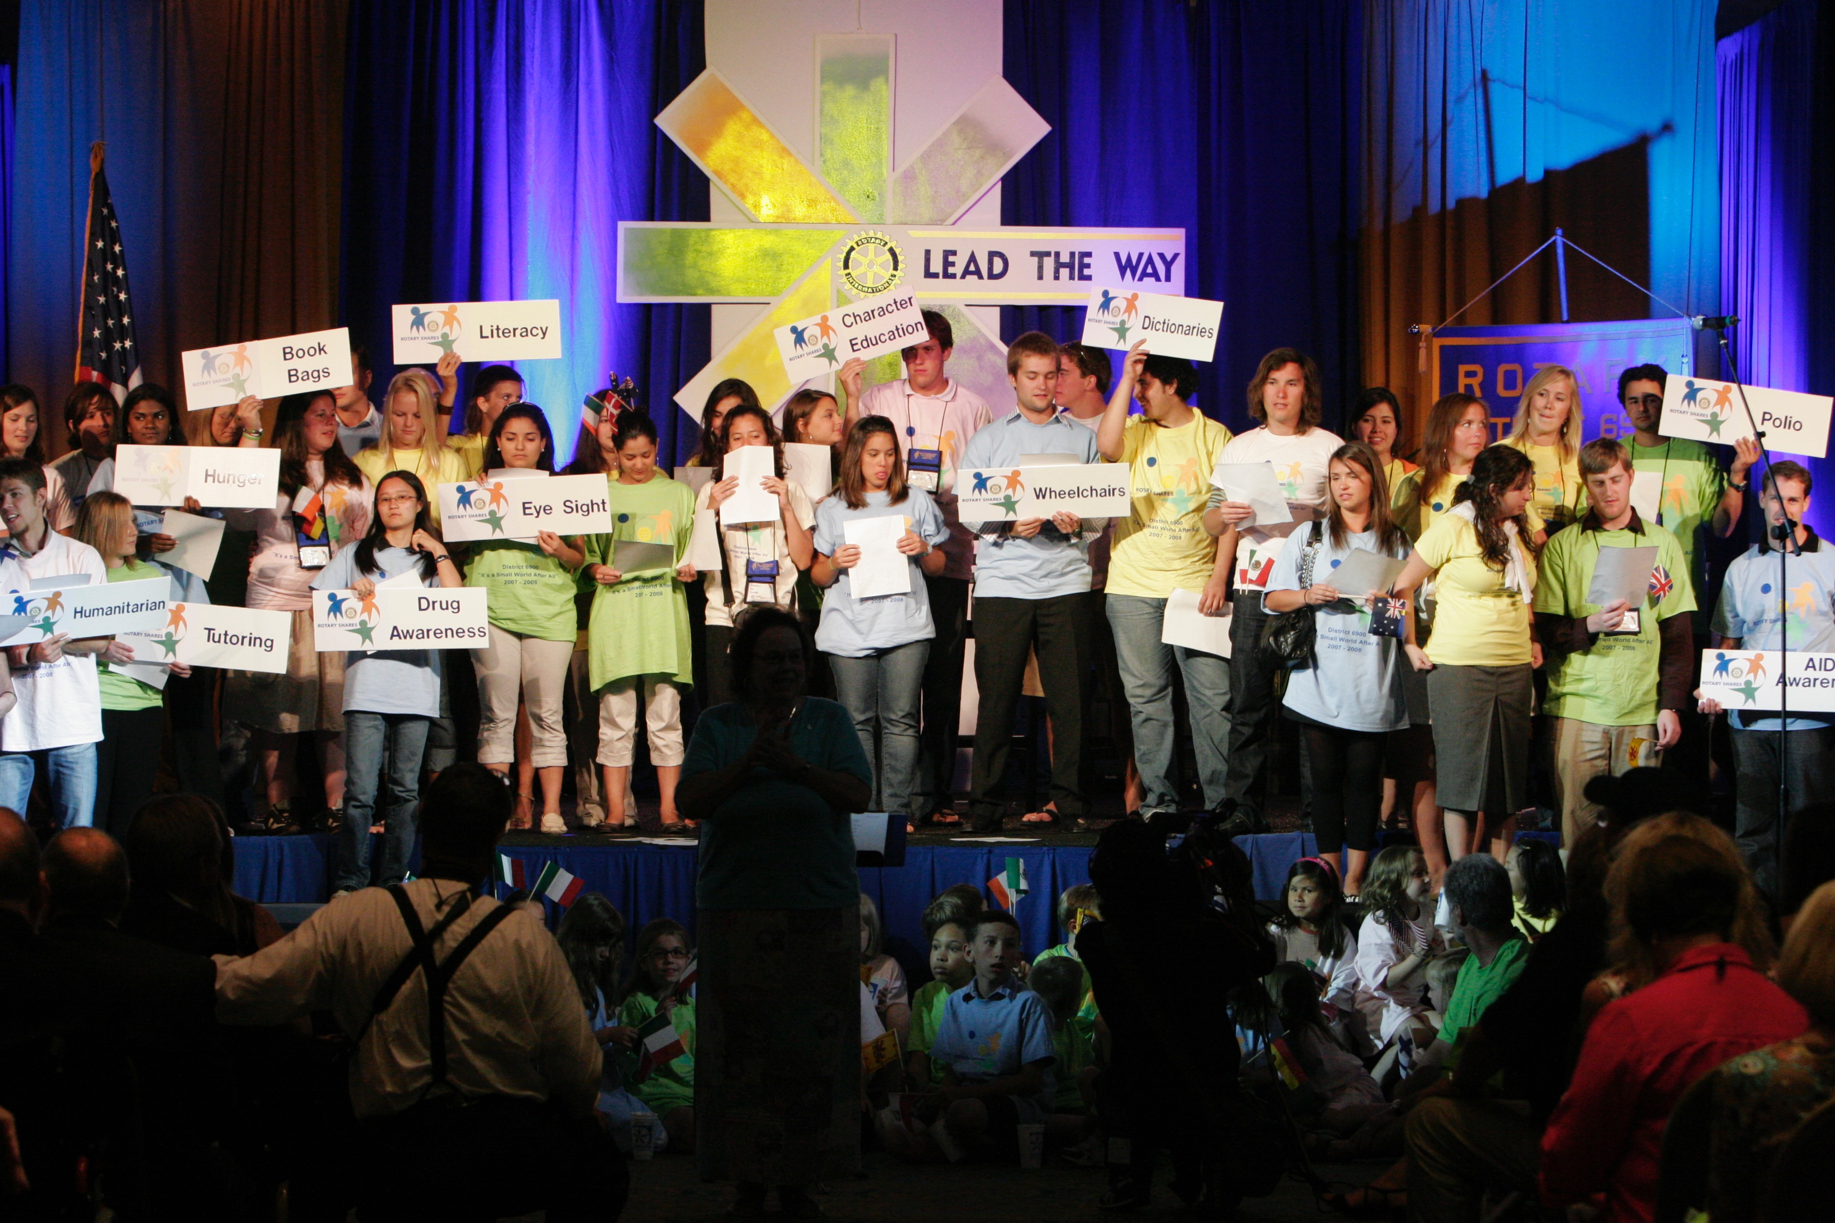
Celebrate Rotary

Slide 5
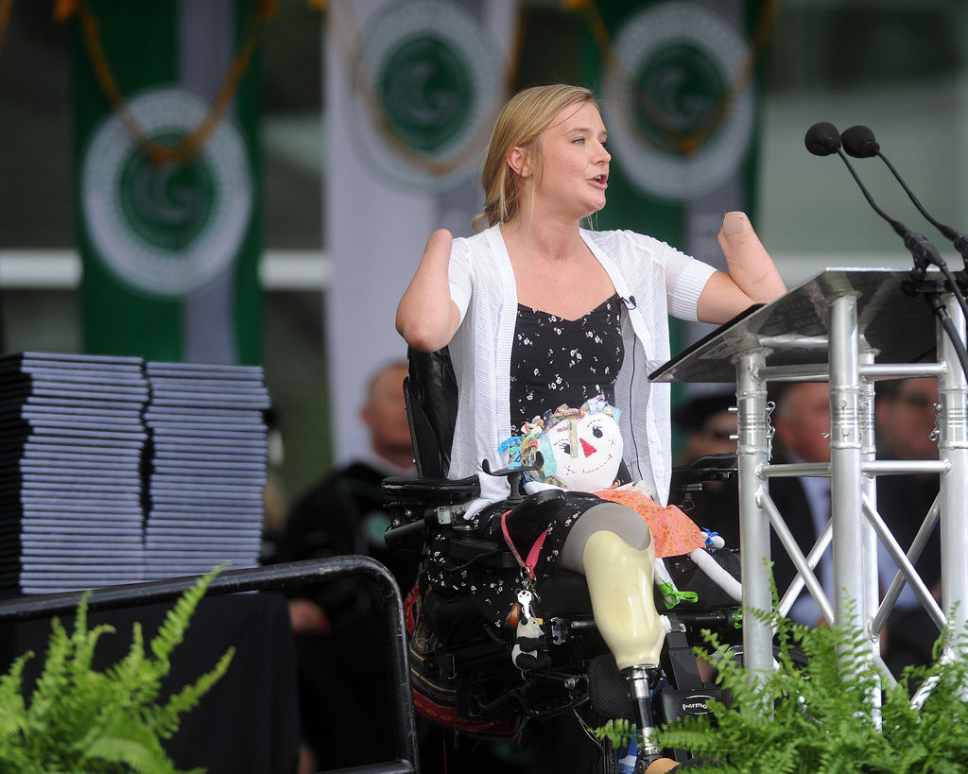
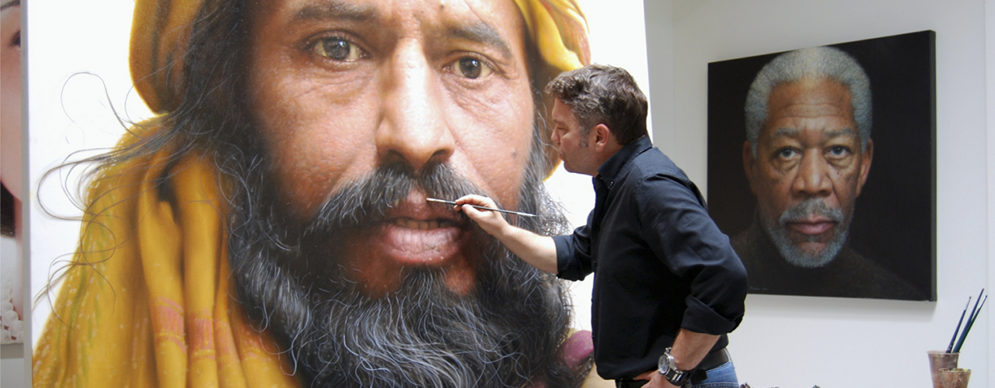
Be Inspired

